Slide 1
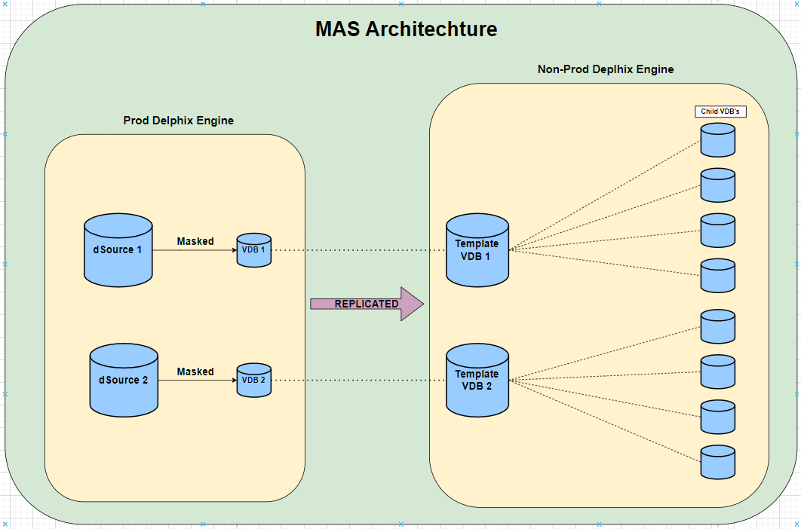

Slide 2
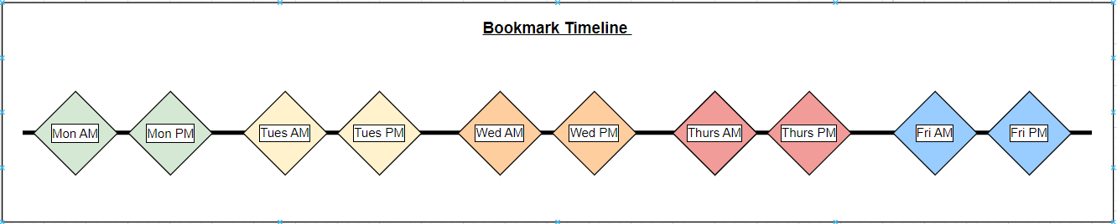
Each child VDB will have access to the same catalogue of bookmarks which they are able to refresh to via the self-service GUI.

Slide 3
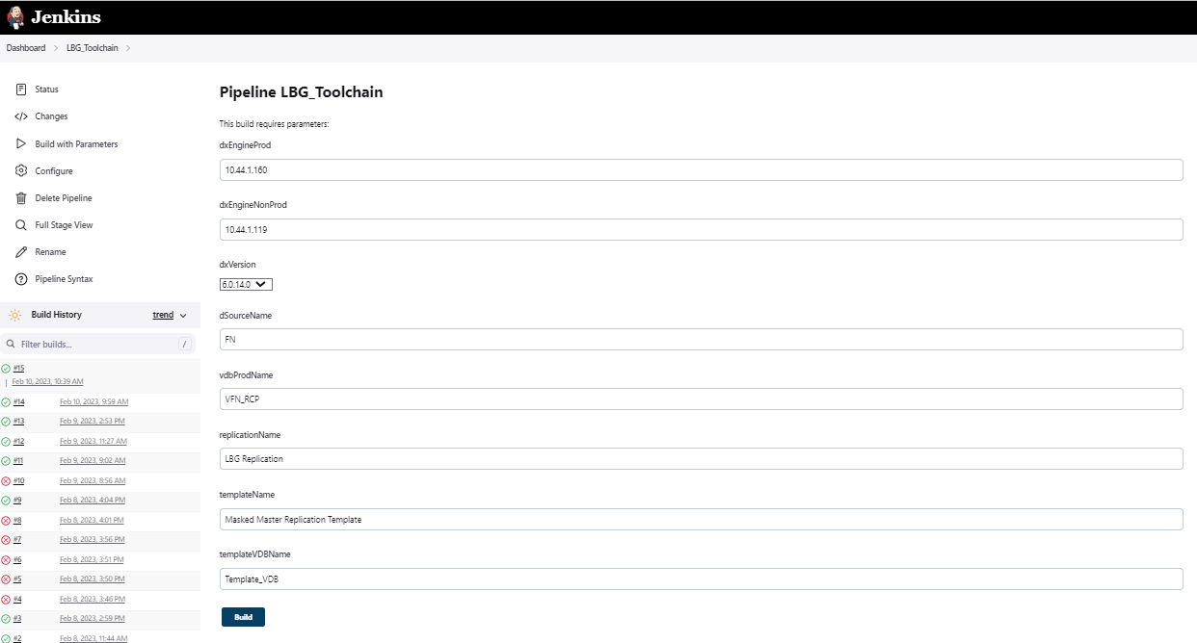
Predefine Parameters & Schedule jobs using Automation tools to capture bookmarks.
Makes a sequence of API calls to the Delphix Engines to execute the commands in sequence

Slide 4
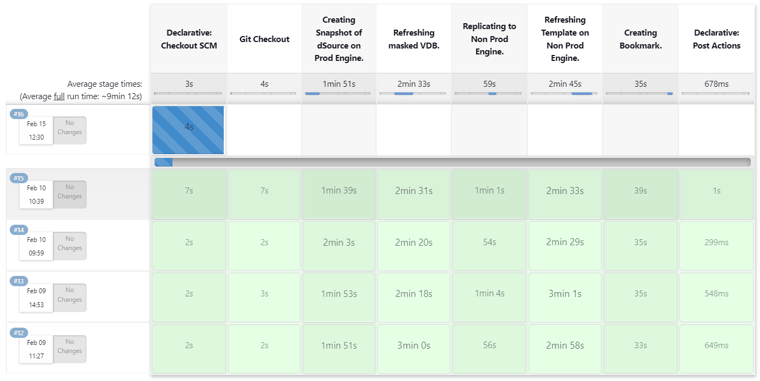

Slide 5
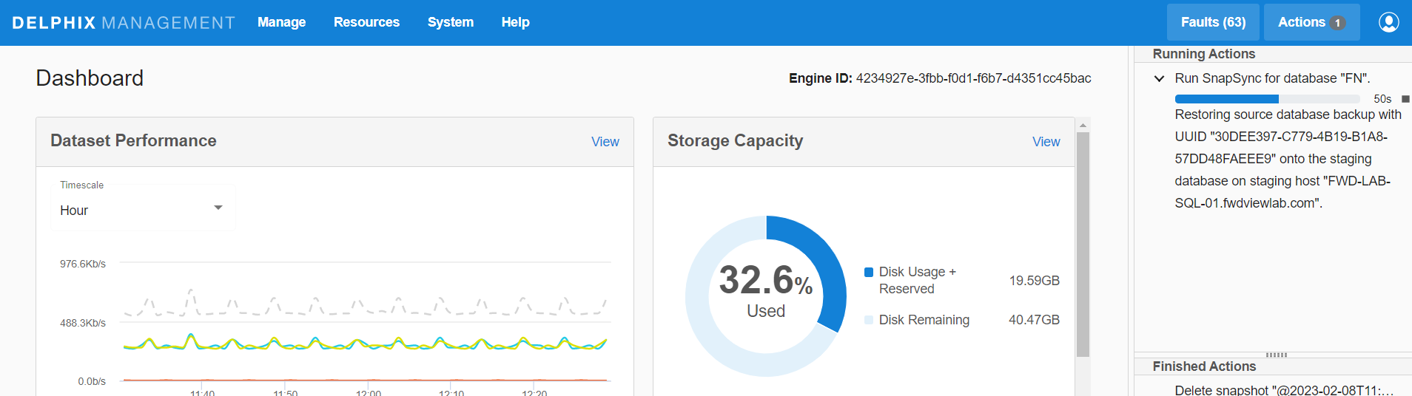
Prod Engine – Snapshot dSource

Slide 6
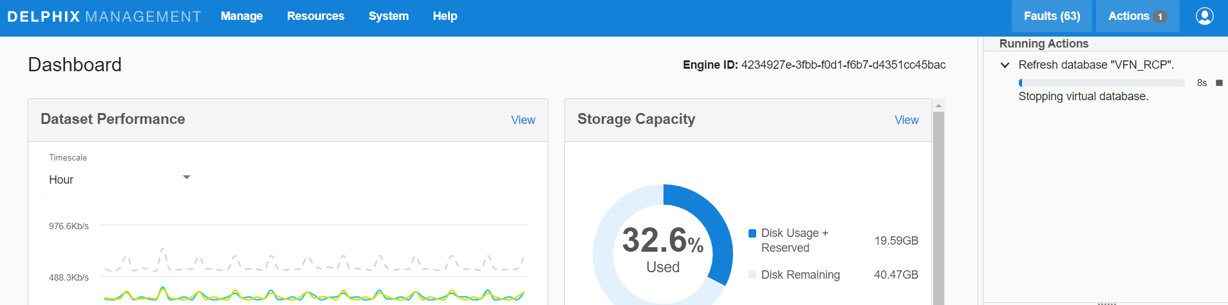
Prod Engine – Refresh Masked VDB

Slide 7
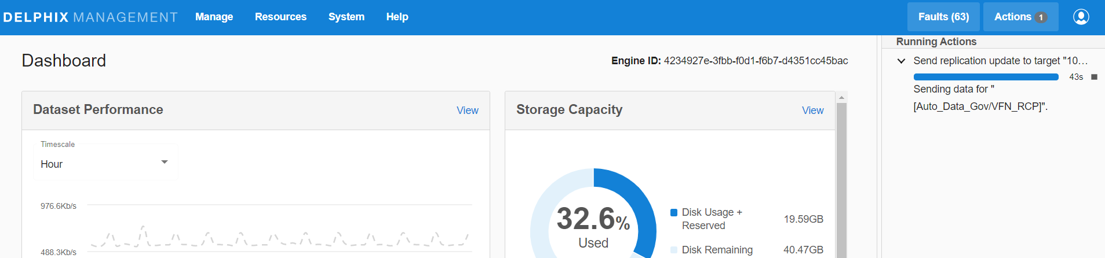
Prod Engine – Replication to Non-Prod

Slide 8
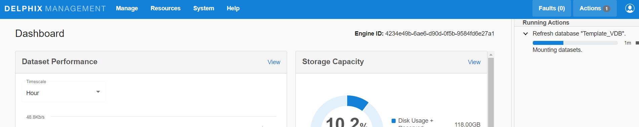
Non-Prod Engine – Refresh Template VDB

Slide 9
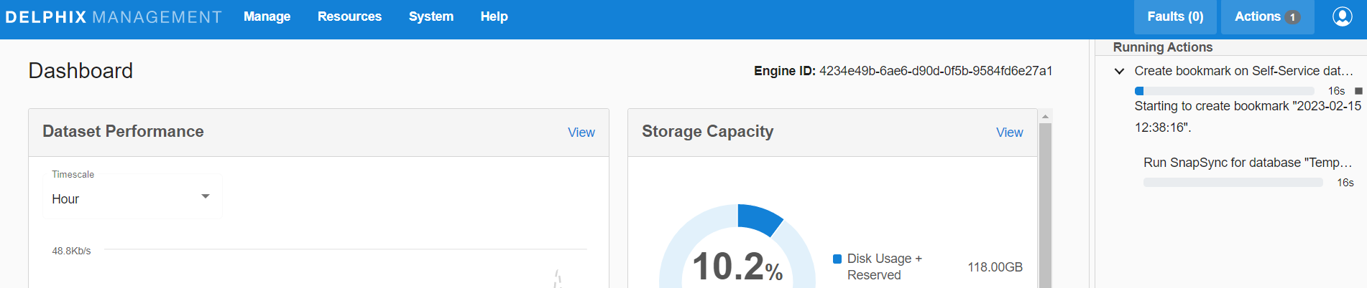
Non-Prod Engine – Bookmark Template

Slide 10
